Slide 1
WELCOME
We will start promptly
at 7 pm

Slide 2
Pledge of allegiance Scout Oath Scout Law

Slide 3
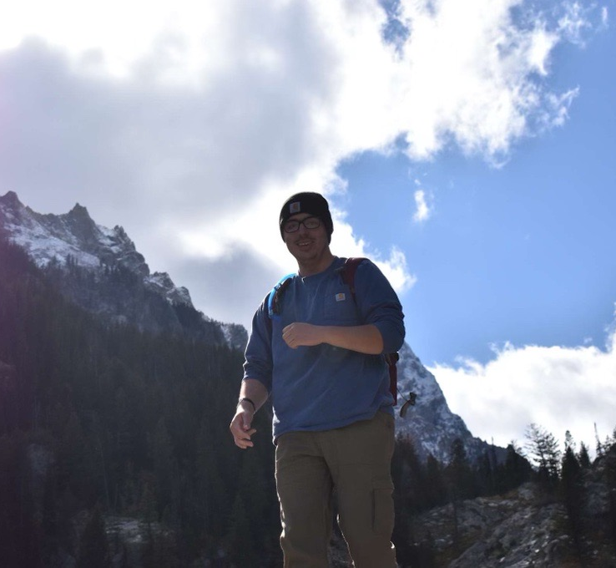
Key Staff Introductions
Medicine Bow Camp Director
Matt Limongelli
Three Point Camp Director
Patrick Dalton
Sandy Beach Camp Director
Steven Renfree

Slide 4
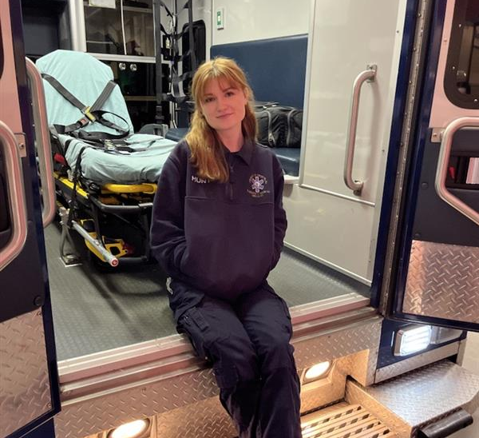
John Vuono
Reservation Superintendent
Max Manning
Food Service Director
Ethan Bachand
Business Manager
Piper Hunt
Health Lodge Director
Quintin Reynolds
Program Director

Slide 5
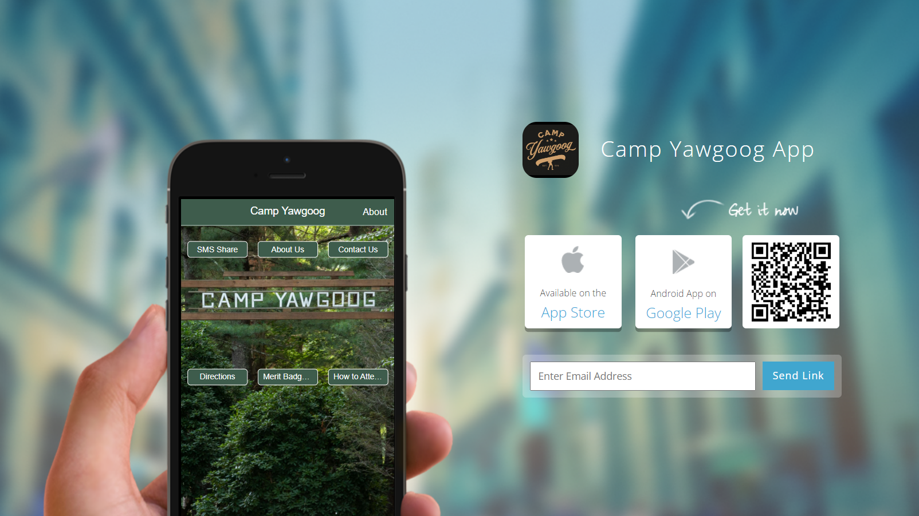

Slide 6
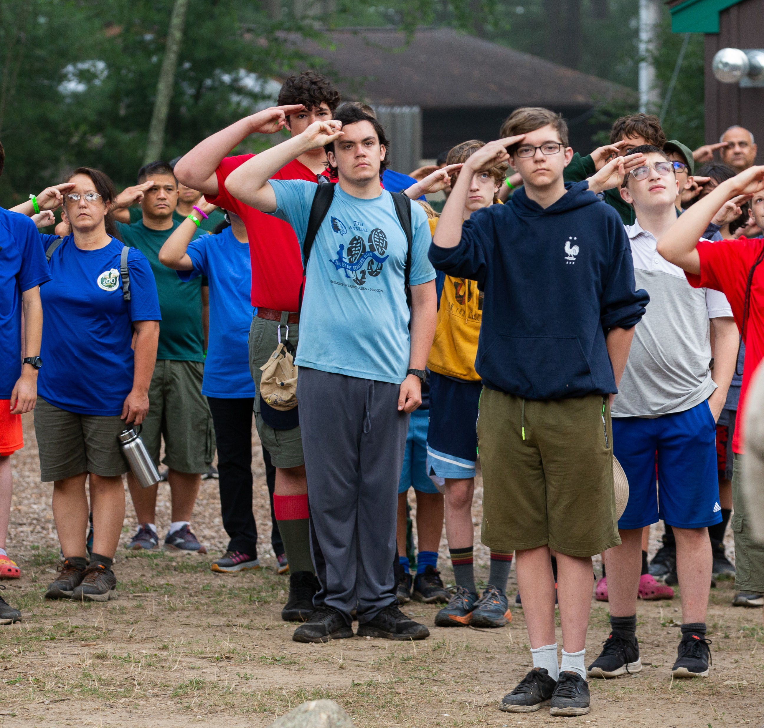
Topics we will cover in this meeting:
Schedule
Ferry/Bussing
Program Updates
Horsemanship
Ice Skating
ATV Program
Provisional Opportunities
Tuesday BBQ
Payments → Black Pug
Pre-Check-In → Black Pug
Health Forms → Camp Doc
Employment Opportunities
Covid-19 Preparations
Sunday Check-In
See you soon!
Our website will have the most up to date information including the
2024 Leaders’ Guide, Schedules, and more

Slide 7
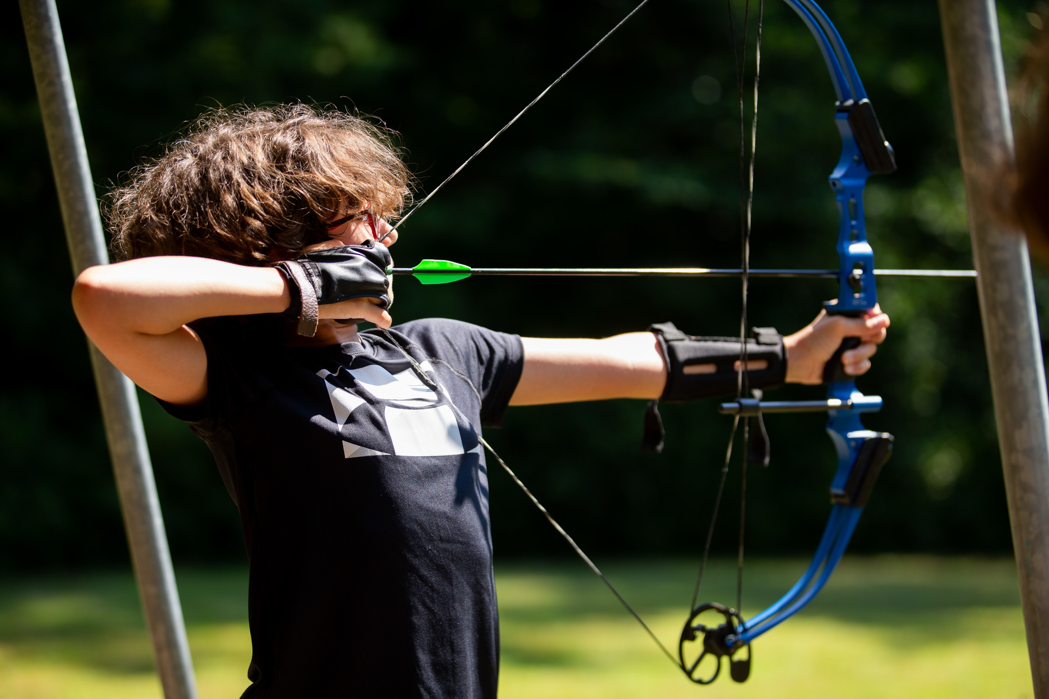
Sunday-to-Saturday Program
Schedule Changes
Arrival on Sunday staggered with troops arriving 12-2pm
Swim Qualifications and Pictures: 1:30pm – 6:00pm
Scoutmaster meeting with Reservation Director after dinner Sunday at 7:00pm @ MBDH
Departure Saturday after Dress Parade
Saturday Breakfast available at 7:30am, Services at 8:30am
A Scout is Reverent 8:30am – 9:30am Saturday
Dress Parade held at 10:15am on Saturday
No Lunch Saturday

Slide 8
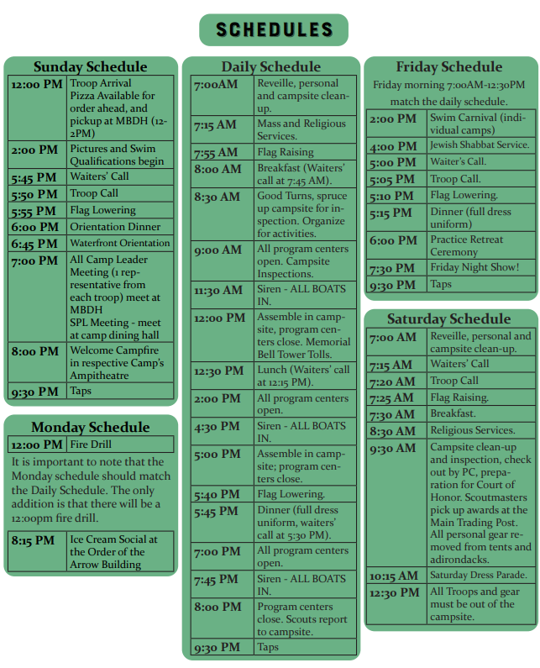
Commissioners

Slide 9
Do you need to take the Ferry?
FERRY RESERVATIONS
Ferry Reservations must be made between June 1 and June 30! PLEASE NOTE THAT THE FERRY FEES ARE SEPARATE FROM AND IN ADDITION TO BUS TRANSPORTATION COSTS. All other Ferry Info and Reservations call:
(860) 443-5281 https://www.longislandferry.com
WHAT TO EXPECT
Yawgoog Scout Reservation will provide bus transportation for those units confirming their needs with the Bucklin Office Staff by the Tuesday prior to their week at Camp. Transportation can only be provided for the above Ferry times. The cost for this service is $15.00 round trip per person. Registration for bussing from the Ferry should be done at least 30 days in advance.
Going to Camp Yawgoog: 10:00 AM Ferry from Orient Point, New York Leaving Camp Yawgoog: Take either the 1:00 pm or 1:30 pm ferry SATURDAY PM Ferry from New London, Connecticut

Slide 10
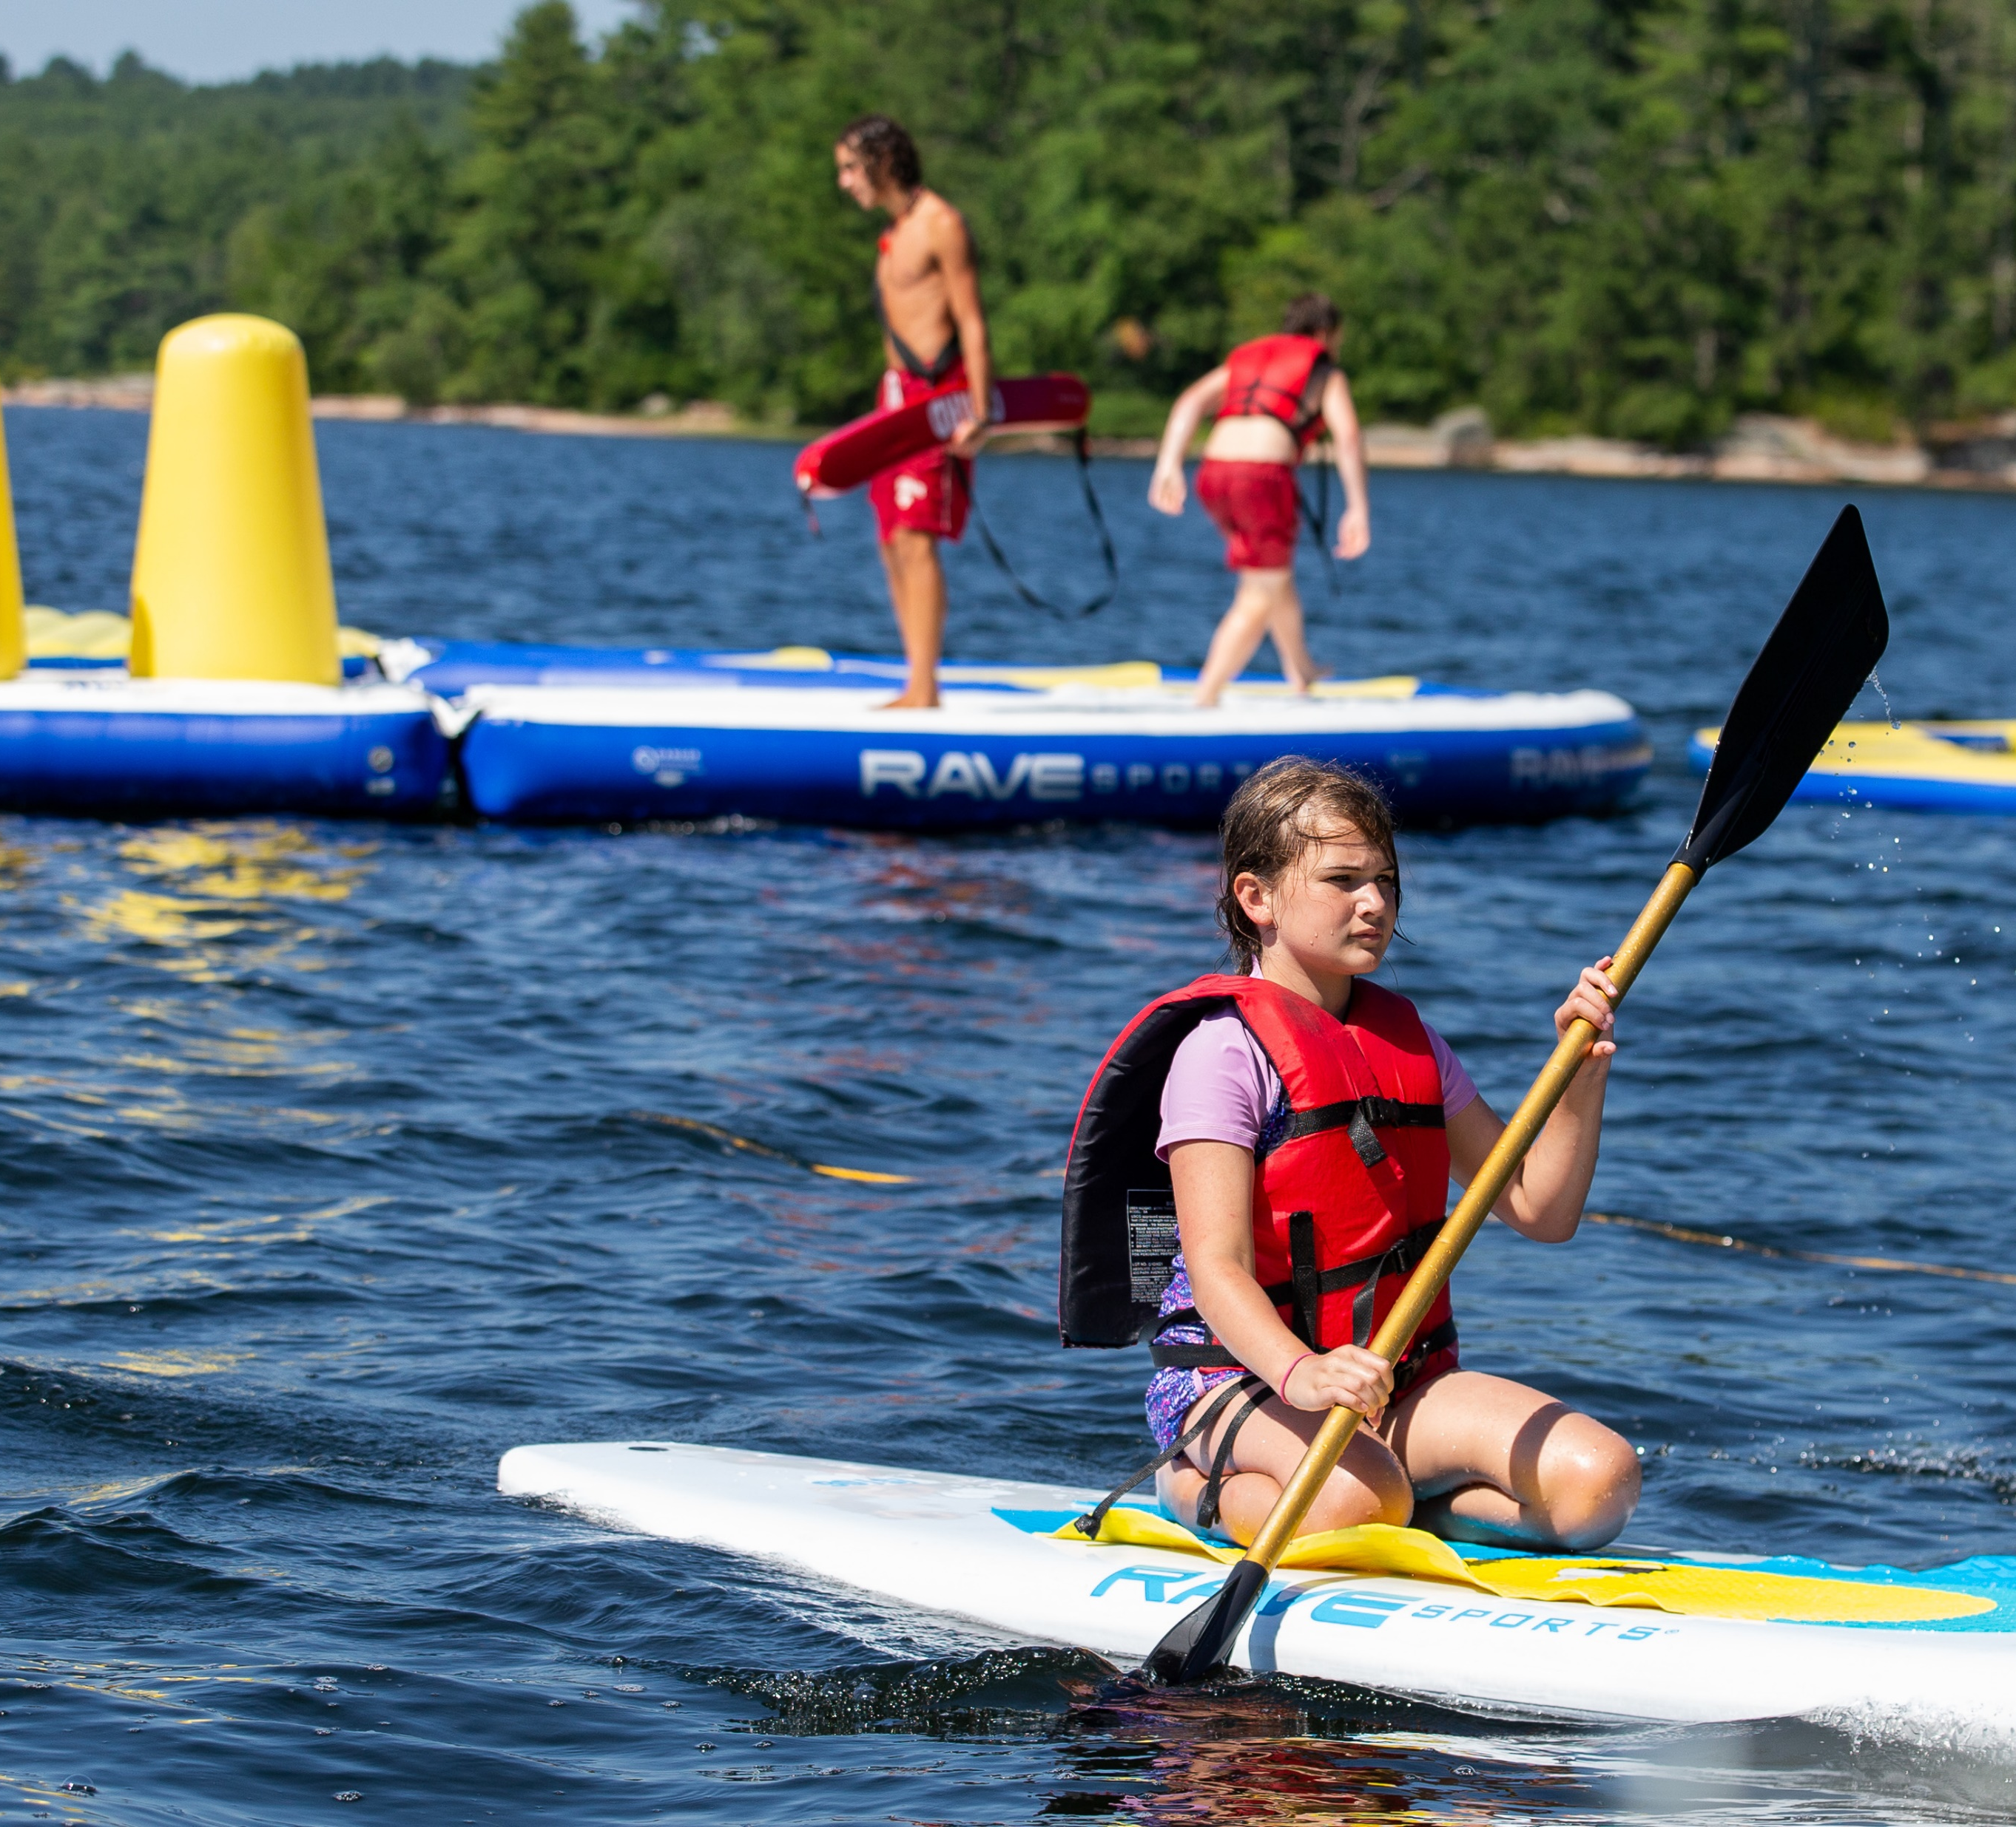
Program Updates
New Axe Throwing Range at the Archery Range
3 War Canoes return to the 3 waterfronts!
6 more paddleboards and 1 more mothership! (1 for each waterfront!)
Branding Night Wednesday 7pm-8pm @ H.C.A.S.
Trivia Night Wednesday 8:00pm @ MBDH
Tie Dye Night Thursday 7pm-8pm @ H.C.A.S.

Slide 11
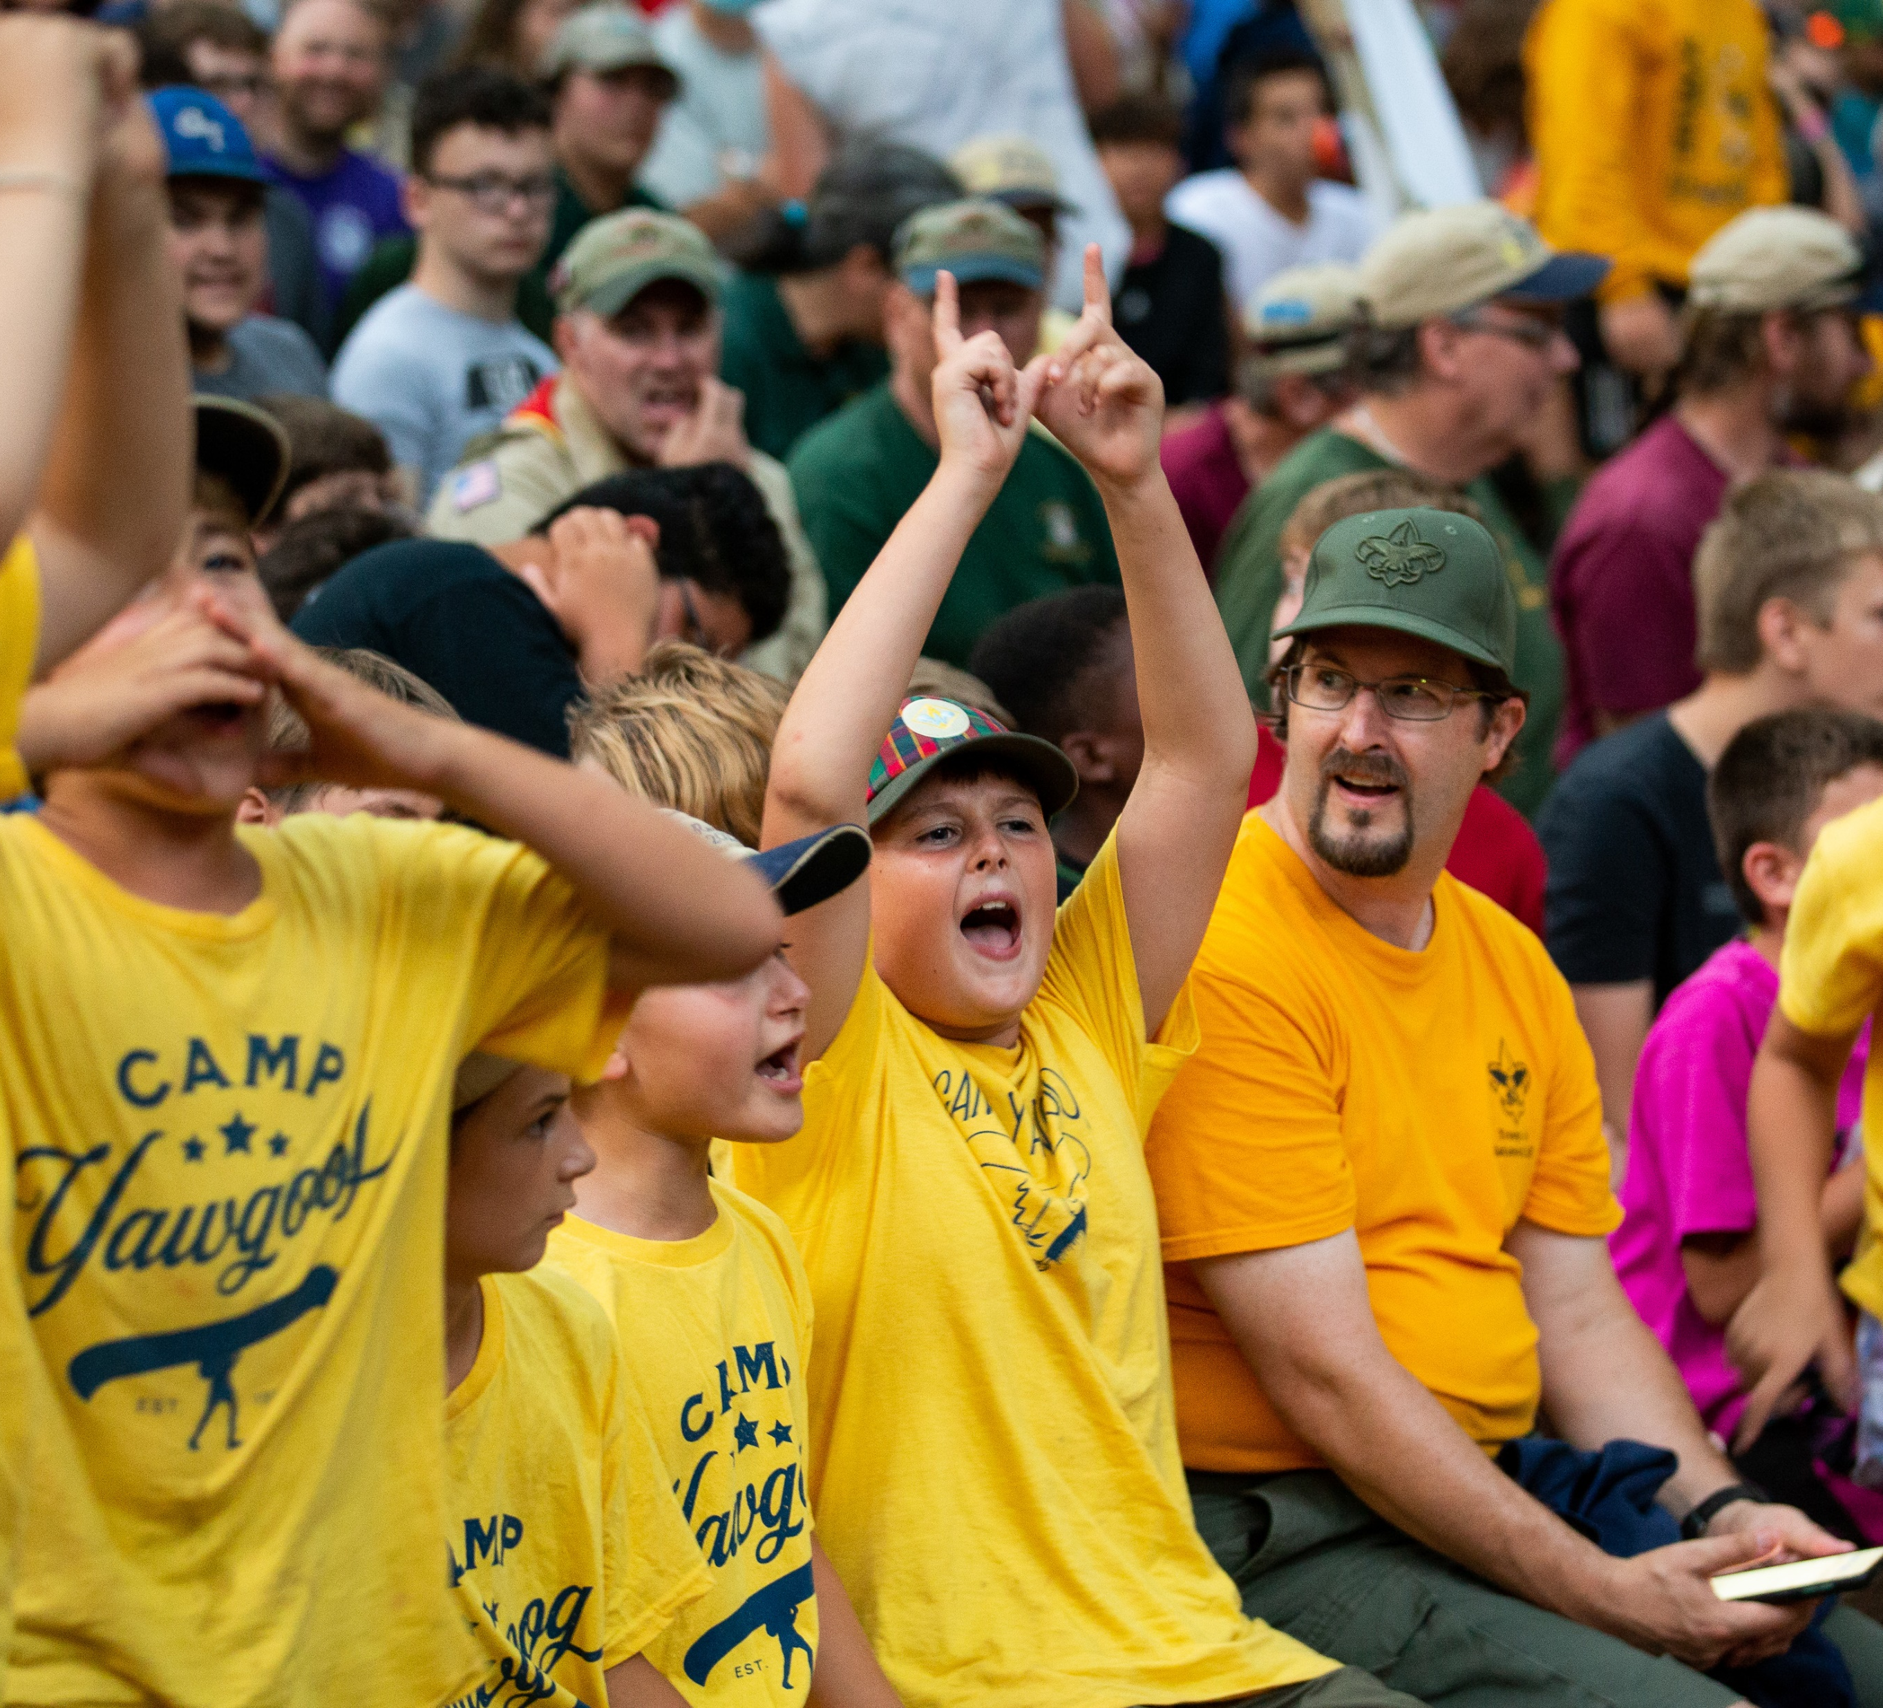
Program Updates
Electricity Merit Badge
Pulp and Paper Merit Badge
Indian Lore and Farm Mechanics rotating out
Electricity in more campsites!
New Campsite – Red Wing

Slide 12
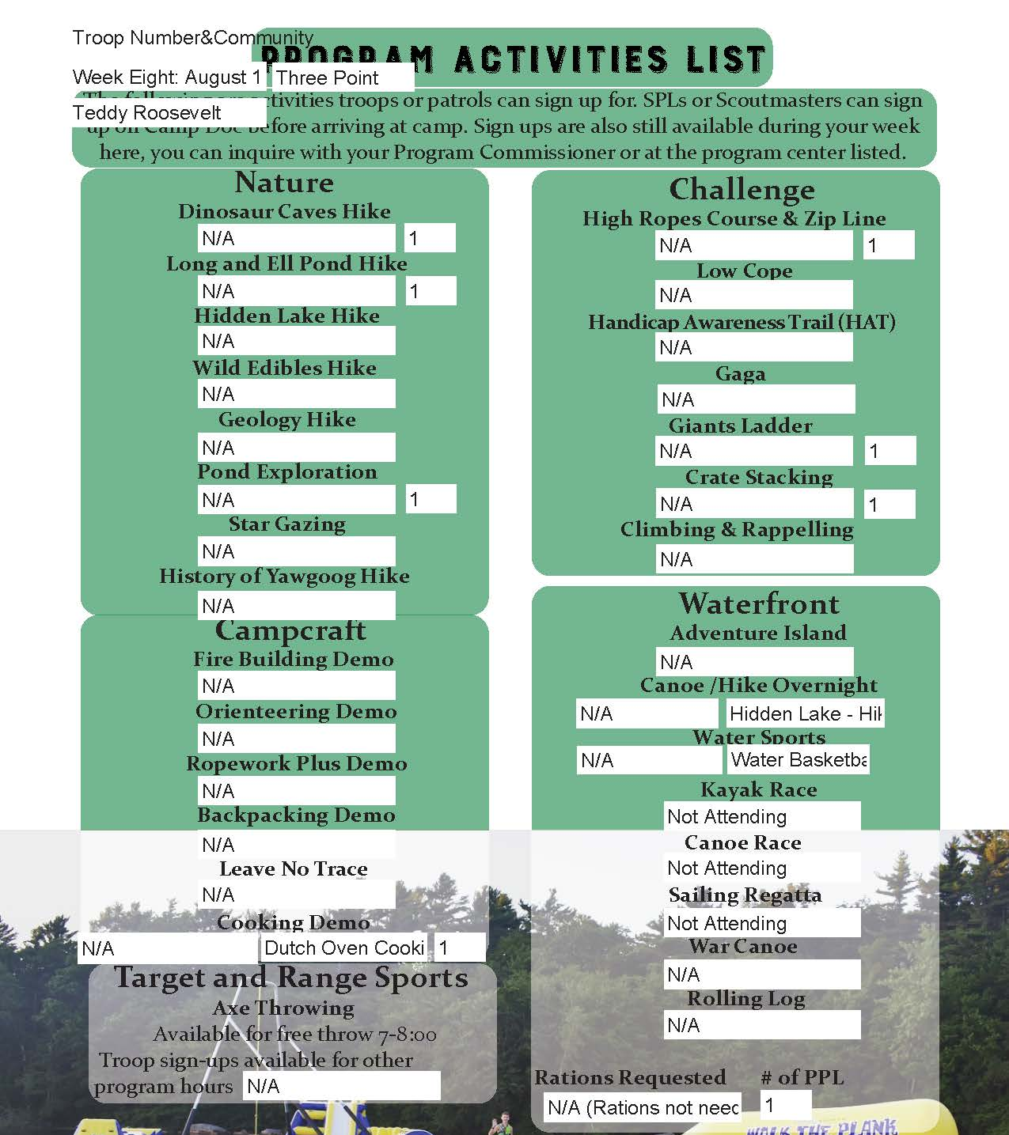
Program Request
Program Request sheets can be submitted through the Registration Contact in Black Pug, or be provided to the Program Commissioners at the Tuesday BBQ. Events also may be scheduled during the week, but will have limited availability to book.
This form is available in the Troops section
www.yawgoog.org/troops

Slide 13
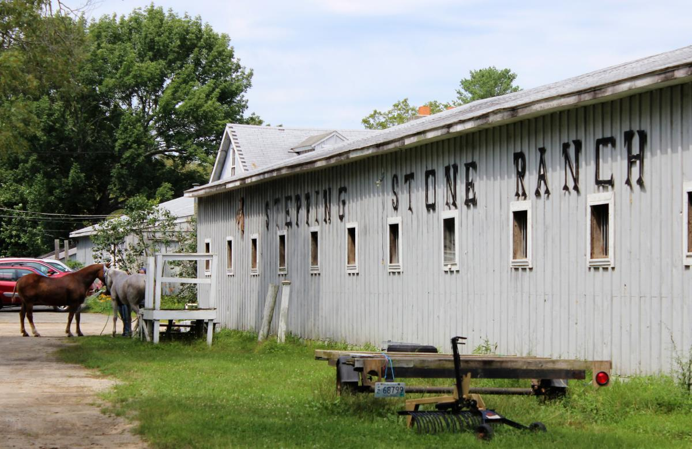
Horsemanship
​Who: All scouts are eligible to sign up. Adults can drive themselves to this event from camp. Photo opportunities encouraged!
What: Scouts can take Horsemanship Merit Badge
When: Monday – Thursday 8:40am – 12:00pm, or 1:40pm – 5:00pm. Weeks 4 and 6 Mon – Wed only.
Where: Scouts meet at the Bucklin Memorial Building at 8:40am, and travel to Stepping Stone Ranch
Cost: $250 per participant (there is a limit of 10 slots per session)

Slide 14
Ice Skating
​Who: All scouts are eligible to sign up. Adults are able to drive themselves to this event from camp, or take the bus depending on space.
What: Scouts have the opportunity to take Ice Skating Merit Badge / go Ice Skating at Boss Arena
When: Friday Meet at 8:00am, Ice Time 9am – 11am
Where: Scouts meet at the 407 at 8:00am, and travel to Boss Arena at the University of Rhode Island
Cost: $35 per participant (there is a limit of 45 slots)

Slide 15
Salad Station
​Who: All scouts and adults are welcome to come up to the salad bar (1 person per table at a time)
What: There is the added availability of more options to supplement meals. See options on next slide
When: Breakfast, after firsts have been served Lunch, after firsts have been served Dinner, after firsts have been served
Where: By the kitchen doors of all dining halls.

Slide 16
Breakfast
Yogurt Cups
Gluten Free Cereal
Oatmeal Cups
Apples
Bananas
Oranges
Peaches
Pears
More variety in fruit throughout the week!

Slide 17
Lunch
Carrot Sticks
Celery Sticks
Ranch
Sun/Soy Butter & Jelly Sandwiches
Fresh Fruit variety

Slide 18
Dinner
Salad has: Salad
Lettuce
Arcadian/Spring Mix
Cherry Tomatoes
Peppers
Cucumbers
Carrot Shred.
Red Cabbage Shred.
Dressing Options –
Italian
French
Ranch

Slide 19
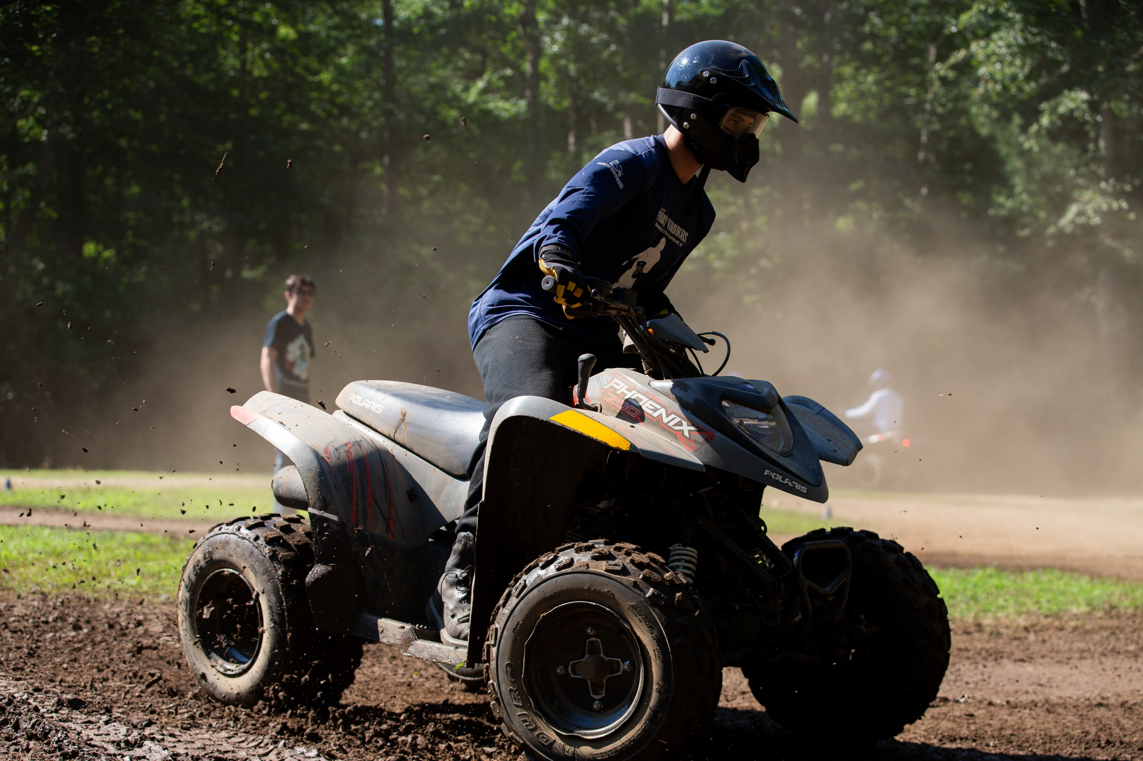
ATV Program
​Who: Scouts 14-17 are eligible to sign up in accordance with the BSA ATV guidelines
What: Participating in the ATV program provides Scouts the knowledge and skills to safely drive an ATV, and Scouts will become certified riders through the Polaris ATV Safety Program.
When: available during normal merit badge sessions 9, 10:30, 2, and 3:30.
Where: Shea Shelter on the Curtis Tract.
Cost: $50 per participant (there is no fee to enter the ATV lottery)

Slide 20
WHY and How Sign up?
Eligible Scouts can enter their names in the wait list now until May 20th. This sign-up will not guarantee participation in the program but will show your interest in participation.
Scouts will be selected by a random lottery. Selected Scouts will be notified June 1. There will be a wait list for any participants in case availability opens up.
7:00-8:00 session Monday – Thursday is open to participants who completed the course last year to trail rides with a group.

Slide 21
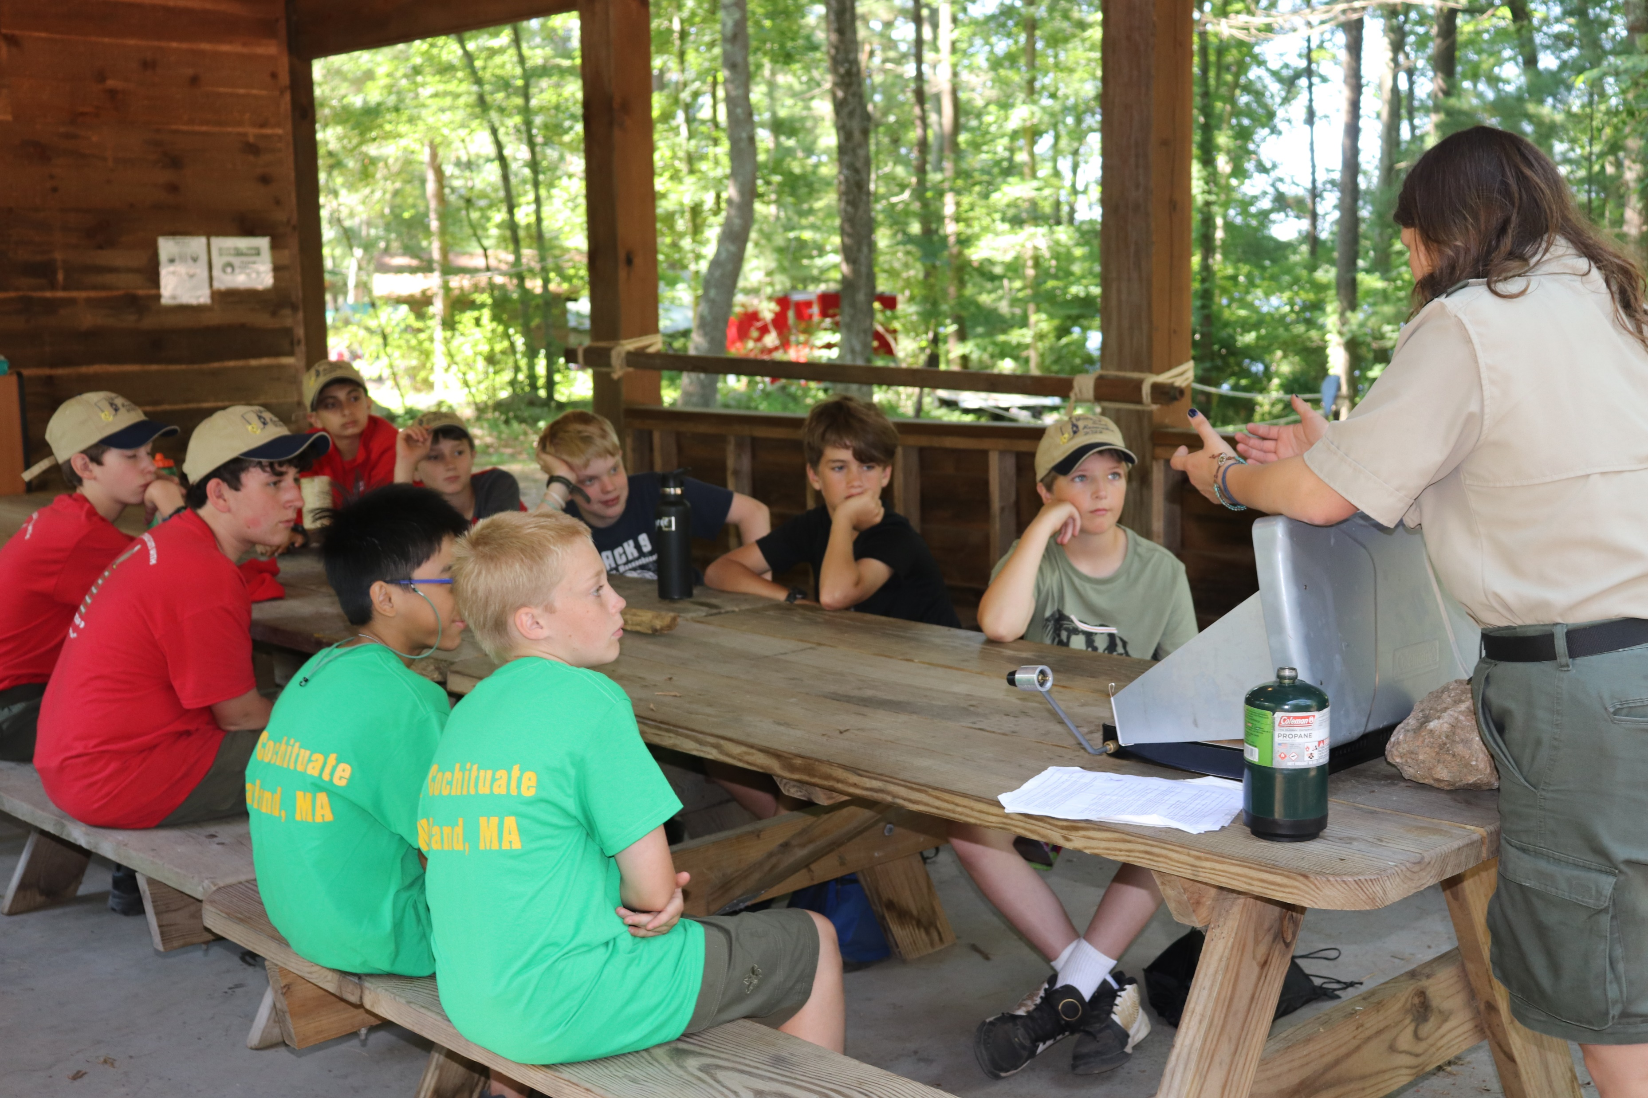
New Frontier Program
“First Year Camper Program” in some camps, here’s how ours works!
Requirements are taught at least twice throughout the week – allowing flexibility around a merit badge
Excellent resource for completing requirements up through first class! Requirements like knot tying,

Slide 22
Provisional Opportunities – Fun Friends Adventure
$590 or $295 as an additional week
Drone Program - 12 scouts per merit badge session
Only available for FFA participants
4 drones
Boy Scouts of America© is an FAA-approved Test Administrator of The Recreational UAS Safety Test (TRUST).
TRUST is a collaboration between the FAA and industry to provide TRUST and educational safety material to Recreational Flyers.

Slide 23
Provisional Opportunities
Fun Friends, Adventure
Webelos Outdoor Adventure
Yawgoog Leadership Experience
Day Camp (Weeks 5, 6 and 7)
Discounts are available for siblings ($50 per sibling), and additional weeks are half off at $295.

Slide 24
Order of the Arrow
OA Ordeal Weekend –
May 17-19
Arrow Corps – Week 7 Cost: $150 for the whole week!
Brotherhood Ceremony Opportunity for Tulpe Lodge members on Thursday Nights.
Fellowship on Monday!
Tap Out Ceremony at the Friday Night Show.
Unit Elections available during your week!

Slide 25
NYLT
Week 8
August 12-17
Camp Yawgoog
National Youth Leadership Training is an exciting, action-packed program designed for councils to provide youth members with leadership skills and experience they can use in their home troops and in other situations demanding leadership of self and others. ... NYLT is a six-day course.

Slide 26
This is the first year that troops will have the opportunity to submit swim classification results ahead of time. Camp Yawgoog will only accept results that are dated January 1, 2024 or later.
There is a link provided in the comments within the registration contact in Black Pug to the form to provide.

Slide 27
Final Payments
Final Payment Packets are due 30 days prior to your arrival at camp.
The only exception will be for a Scout that has signed up after the 30 days. Scouts may be added on until the day of camp.
Payments, and forms that are missing will be a $25 late fee per form.
The Parent Portal is an optional feature that allows you (the registration contact) to provide your parents with access to just their Scout's part of the registration, to make payments and complete data entry such as access to sign up for merit badges ahead of time. Scouts that add merit badges that have a cost will be added to the troop total and applied to the individual total for payments. (Horsemanship, ATV, Ice Skating, Leatherwork, Basketry, Woodcarving, etc.)
Troops will receive their check-in time, picture time, and swim qualification time ahead of time in Black Pug. This will be in the registration contact section.
Troops must pay through the system or use the parent portal for payments, or provide one troop check via mail.
Troops not adhering to this policy will NOT be allowed in camp.

Slide 28
Final Payments
Discounts –
Sibling - $50 per sibling
National High Adventure Discount - $100 (National High Adventure Bases Only)
Additional Week Cost - $295 / week
Adventure Card Discount of $20 per scout to match in Council Pricing in System for Spirit of Adventure Troops
New Scout Discount of $99 eligible for Mayflower, Narragansett and Spirit of Adventure Councils. New Scouts who joined Sept. 1, 2023 or later can attend for $99! Use this for spring recruitment!!
Starting May 1, we will be entering in camperships and applicable discount codes ie Adventure Card and New Scout Discounts. Within Black Pug, there is the opportunity to use self entry for us to verify starting on May 1, ie adults splitting the week, put that information now, so it can get approved and discounts can be added for final fees to be paid 30 days in advance.

Slide 29
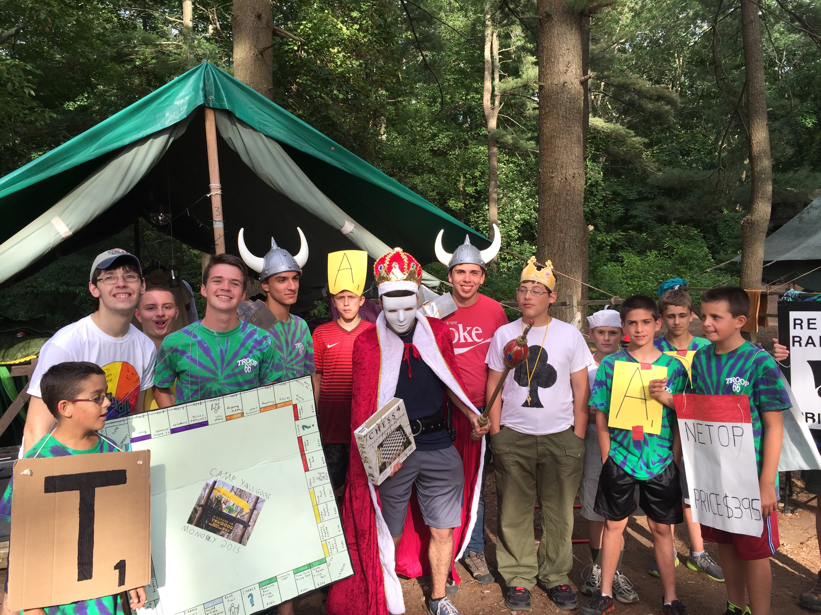
2024 PRE-CHECK-IN INFORMATION
https://www.yawgoog.org/troops
Payments, Health Forms, Unit Behavior Plans, all Forms to Complete - are due 30 days prior to your arrival at camp.
Checklist found on website!
Troops will be able to view their check-in time, swim qual time, and picture time after submitting their final payment on their Black Pug Troop Profile. You will need this to check-in Sunday with any corrections or final changes.
Troops not adhering to this policy will NOT be allowed in camp.

Slide 30
Who – Everyone will use this who is staying on property
What – Online Medical Forms and Troop Submissions
When – Access is available now to troop leaders → who upload the troop roster
Where – www.yawgoog.org/campdoc
Why – 21st century, data retention, health lodge benefits, scoutmasters and troop representatives have an easier time collecting info, provides emergency contacts in a centralized location, and much more.

Slide 31
Health Forms
Every Scout and adult attending Yawgoog must have their health profile completed in Camp Doc on Sunday check in to be allowed to stay on the Reservation.
Doctor’s Signature - Each Scout and adult must have a medical exam given within 12 months of going to camp.
https://www.yawgoog.org/health-forms

Slide 32
Covid-19, Norovirus, Flu… Health and Safety Preparations
Self Screening to be completed by all troops, with a roster presented at check-in that all have completed the self-assessment. (Self Screening – Symptom Check, not a test)
Symptom Check Daily
Wash your Hands
HYDRATE
Check for Ticks
Heat Stroke / Exhaustion

Slide 33
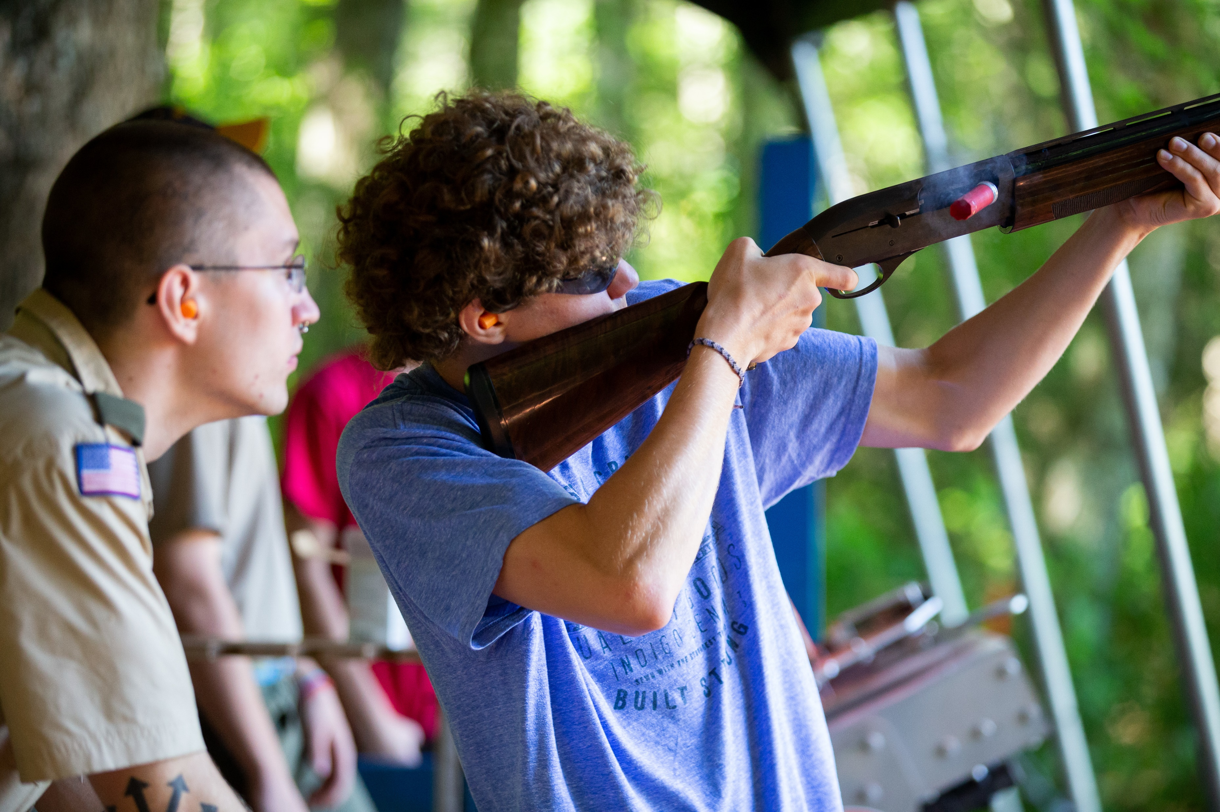
Employment Opportunities
Summer employment opportunities are available!
We provide scholarship opportunities consisting of over $40,000 in scholarships!
Starting salary 2021 -> $1,400
Starting salary 2022 -> $2,000
Starting salary 2023 -> $2,060
Starting salary 2024 -> $2,100
www.yawgoog.org/jobs

Slide 34
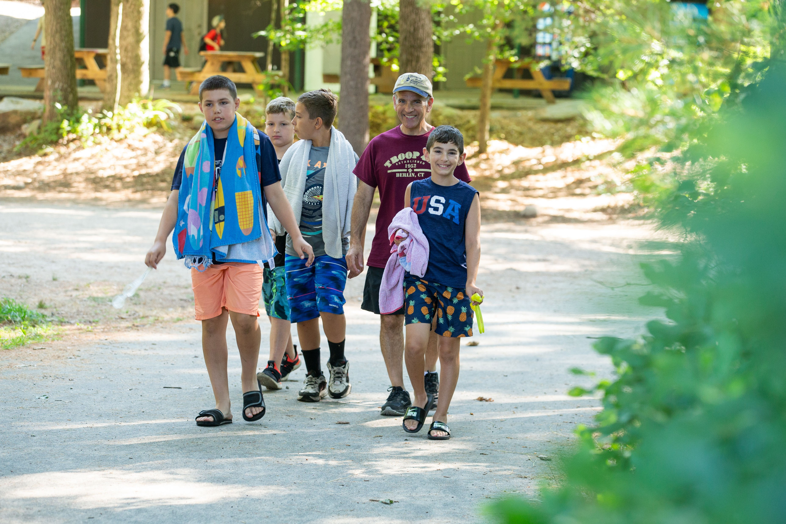
Visitors
Discouraging family nights – less homesickness with no family nights
Any visitors should check in at the Bucklin and be prepared to fill out a self screening assessment and receive a wrist band.

Slide 35
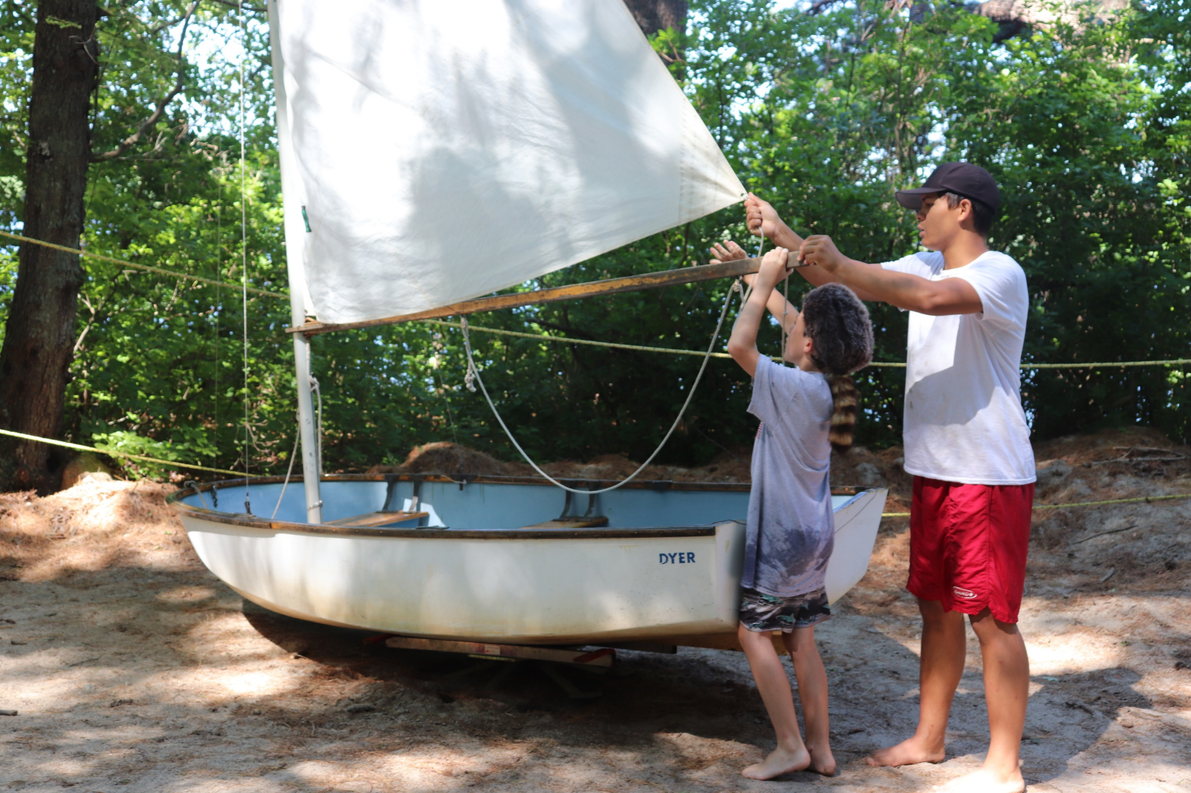
Tuesday BBQ for SPLs and Scoutmasters!
This is a great opportunity to finalize any details for payments/registration and get last minute questions answered.
Troops will have signed up for activities on the Program Request sheet (found in the Troop Section) like nature hikes, Adventure Island, pond expos and more prior to the BBQ, and get a preview of their schedule at the BBQ.

Slide 36
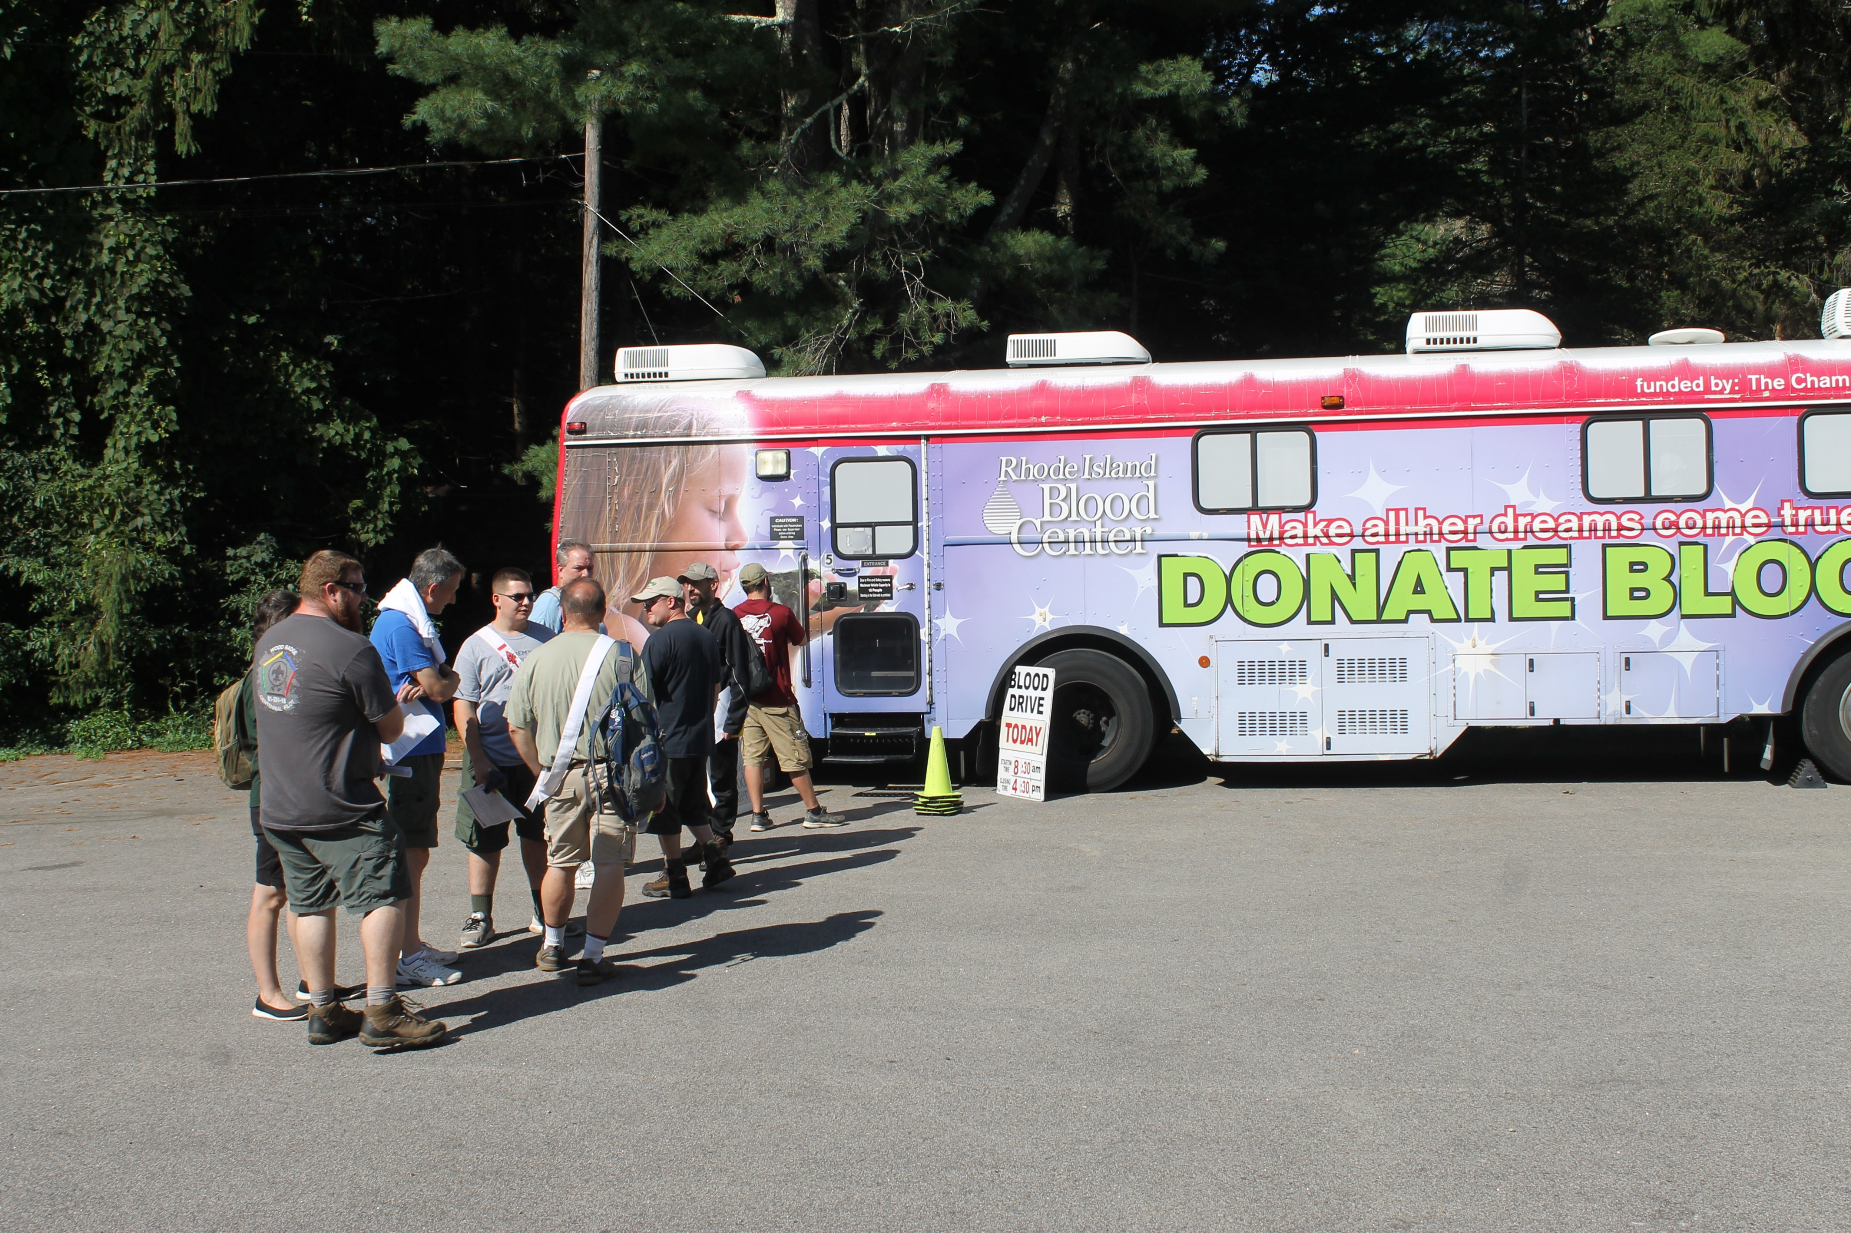
Blood Drive Fridays! Sign up at the Bucklin!

Slide 37
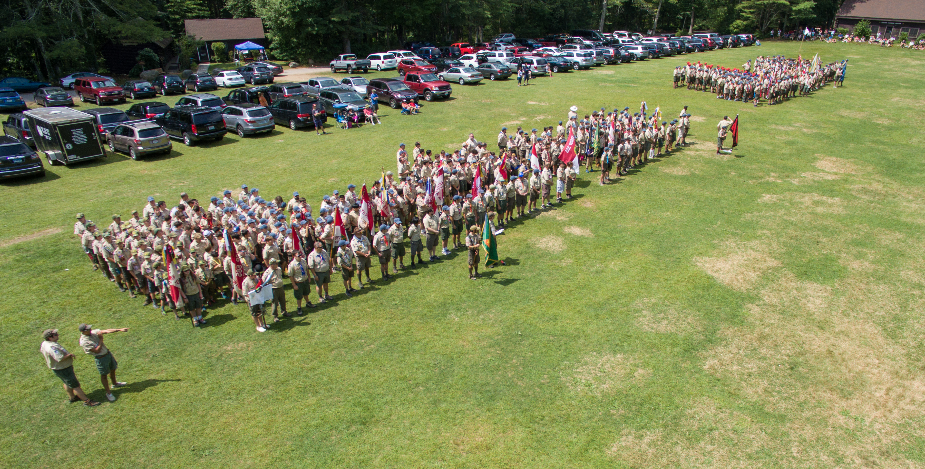
Thank you for attending!
See you soon!

